Slide 1
AI Agent Security Requirements
Yuan Ni, Chunchi Peter Liu
IETF 124 Montreal

Slide 2
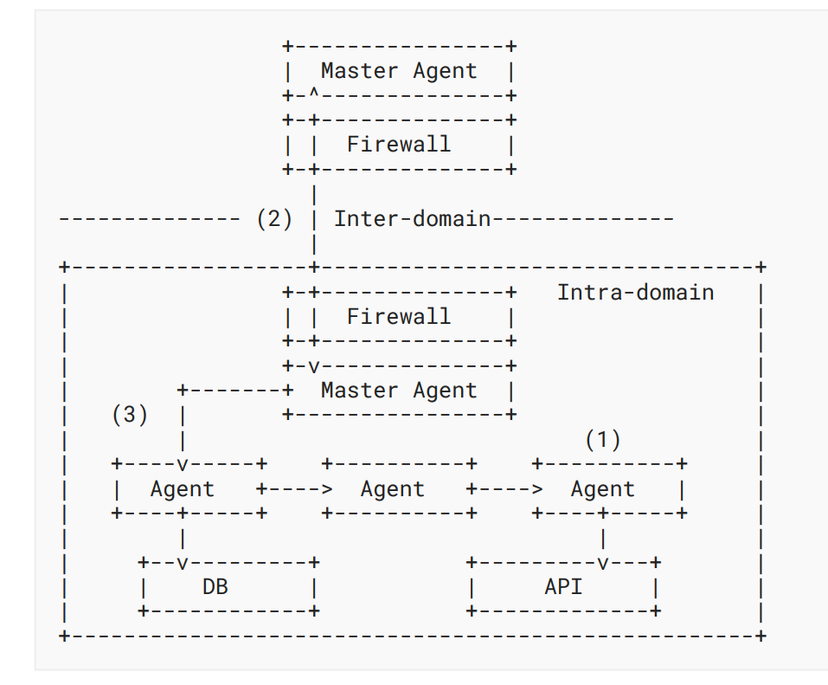
What: Security-related interactions for AI Agents
There are three types of security interactions, in a sequential order:
Provisioning and Registration: Creating agent identity, establishing initial trust, provisioning agent secrets and credentials.
Cross-domain Interconnection: Enabling secure, authenticated communication between agents across different trust domains.
Access Control: The Master Agent validates both intra-domain and inter-domain access tokens, creates internal workflow and manages different credentials for heterogeneous systems.
Architecture of Agent Security Control and Management

Slide 3
Why: You want the following features for AI Agents
Distinct identities and credentials from human
Visibility at network and application level
Network access control and application access control
Explicitness in workflow
Accountability

Slide 4
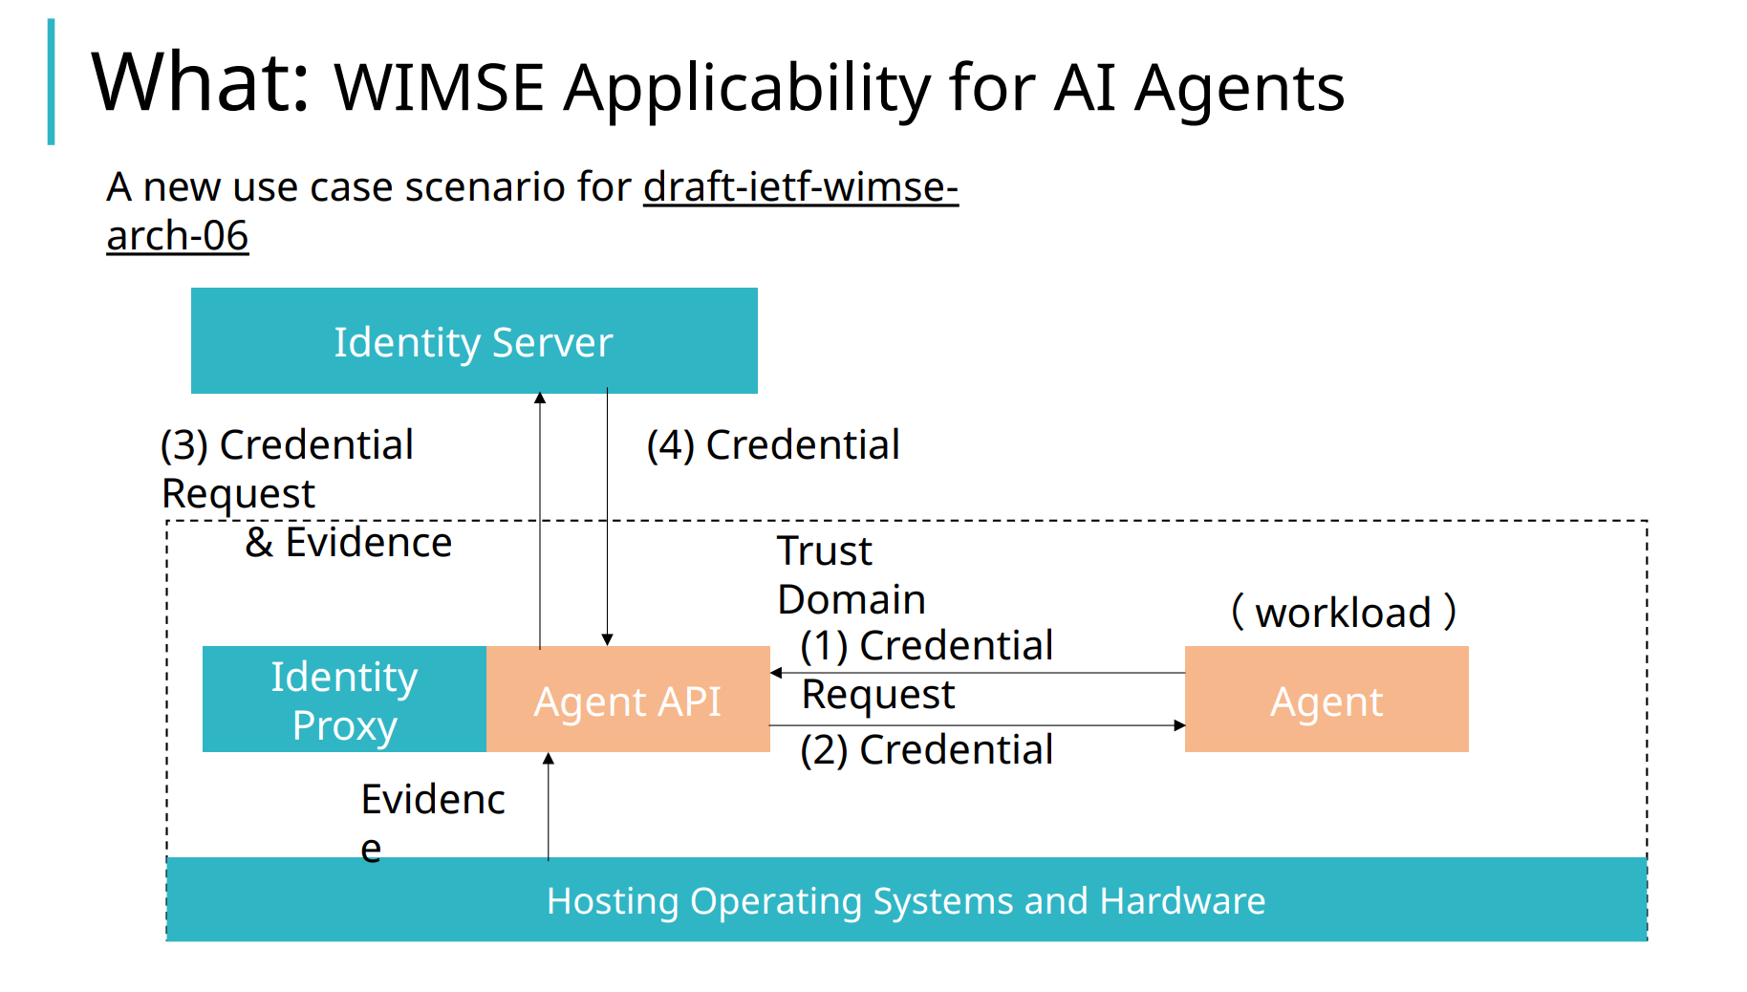
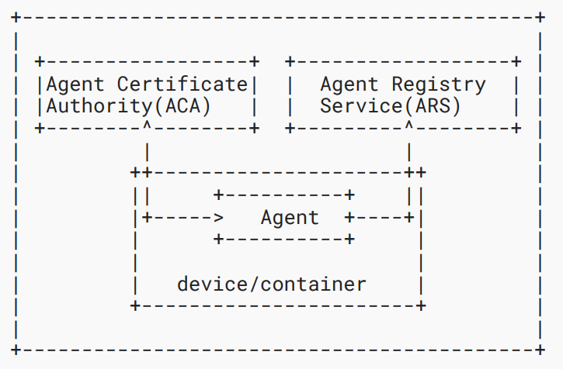
How: Provisioning and Registration
Installing identities and credentials
Diagram for Provisioning and Registration

Slide 5
How: Provisioning and Registration
Identity Provisioning and Management
  Initial Trust Establishment
  Credential Request
  Credential Issuance
  Credential Lifecycle Management
Agent Registration
  Authentication
  Registration
  Record Management
Agent Onboarding
  EAP-TLS

Slide 6
How: Cross-domain Interconnection
Cross-Domain Identifier Interoperability
  Pre-configured schema translation
  cross-domain identifier synchronization
  a universal parsing framework or system
Secure Cross-Domain Transmission
  mTLS, HTTPS
Authenticating External Calls
  API keys
  Username-password
  Pre-shared secrets
  Assertions (for example, JWT Authorization Grant [I-D.draft-ietf-oauth-identity-chaining-06].
IAM Integration

Slide 7
How: Access Control
Authorization Handling
Authorization Chaining Across Domains
  Verify (and preserve) original requesting agent identity
  Verify (and preserve) authorization context
  The current best practice is [I-D.draft-ietf-oauth-identity-chaining-06].
Converting to Internal Workflow
  Workflow Generation
  Downscoping [I-D.draft-tulshibagwale-oauth-transaction-tokens-05].
Interoperability for Heterogeneous Systems
  Bearer tokens
  API keys
  Username-password
  Pre-shared secrets
  X.509 certificates
Zero Trust Analysis
  Attestations
Microsegmentation

Slide 8
Interested?
Take a look at draft-ni-a2a-ai-agent-security-requirements
If you want in, email:
  Liuchunchi(Peter) liuchunchi@huawei.com
  Yuan Ni niyuan1@huawei.com

